Slide 1
Theory on
Internal Auditing

Slide 2
Definition of Internal Auditing
The Definition of Internal Auditing (IIA)
Internal auditing is an independent, objective assurance and consulting activity designed to add value and improve an organization's operations. It helps an organization accomplish its objectives by bringing a systematic, disciplined approach to evaluate and improve the effectiveness of risk management, control, and governance processes.

Slide 3
Components of internal audit
Internal control systems operate at different levels of effectiveness. Determining whether a particular internal control system is effective is a judgement resulting from an assessment of whether the five components - Control Environment, Risk Assessment, Control Activities, Information and Communication, and Monitoring - are present and functioning. Effective controls provide reasonable assurance regarding the accomplishment of established objectives.

Slide 4
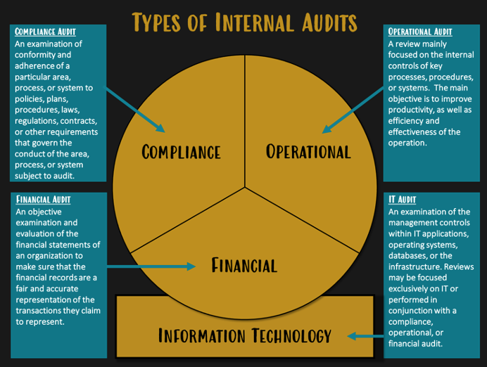
Types of internal Audit emporia state university

Slide 5
Types of internal Audit emporia state university
A compliance audit is an examination of conformity and adherence of a particular area, process, or system to policies, plans, procedures, laws, regulations, contracts, or other requirements that govern the conduct of the area, process, or system subject to audit.
An operational audit is a review mainly focused on the internal controls of key processes, procedures, or systems. The main objective is to improve productivity, as well as efficiency and effectiveness of the operation.
A financial audit is an objective examination and evaluation of the financial statements of an organization to make sure that the financial records are a fair and accurate representation of the transactions they claim to represent.
An information technology audit is an examination of the management controls within IT applications, operating systems, databases, or the infrastructure. Reviews may be focused exclusively on IT or performed in conjunction with a compliance, operational, or financial audit.

Slide 6
Comparison to External Audit
The purpose of internal audit is to analyze and improve organizational controls and performance. The purpose of external audit is to express an opinion on the organization’s financial condition and financial reporting risks.

Slide 7
THE RELATIONSHIP BETWEEN INTERNAL AND EXTERNAL AUDIT
Analyzing the evolution process of internal audit, from its beginnings and so far, we can easily notice that internal audit function was born through detaching of some activities from external audit, the result being that there some situations when these two functions could be easily confused.
The reality is that internal audit and external audit are two distinctive functions; net differenced, but which are also characterized through some complementary relationships.
(Atanasiu Pop, Cristina Boţa-Avram and Florin Boţa-Avram, 2008)

